Slide 1
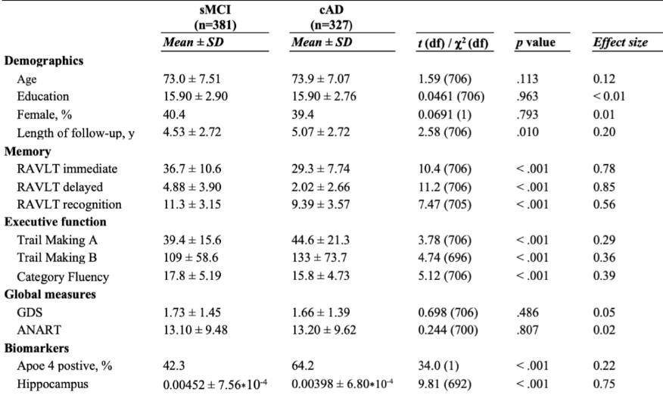
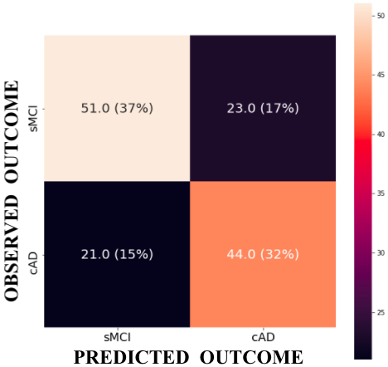
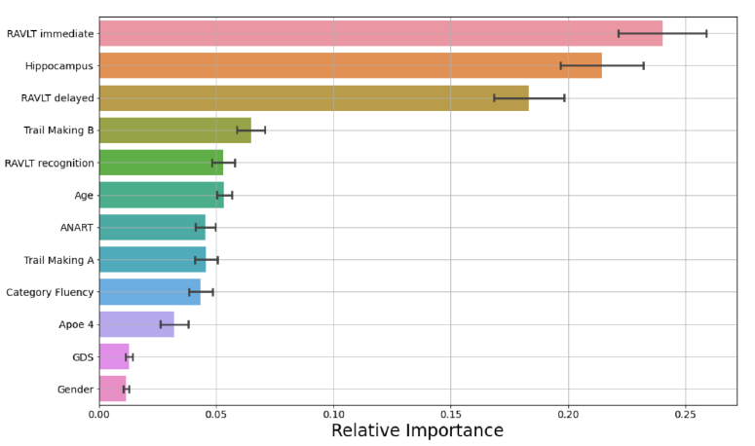
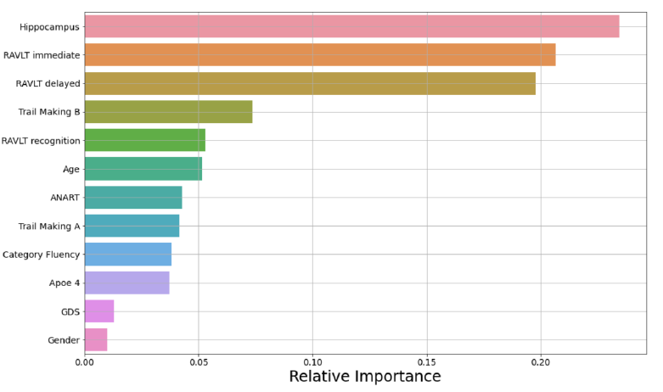
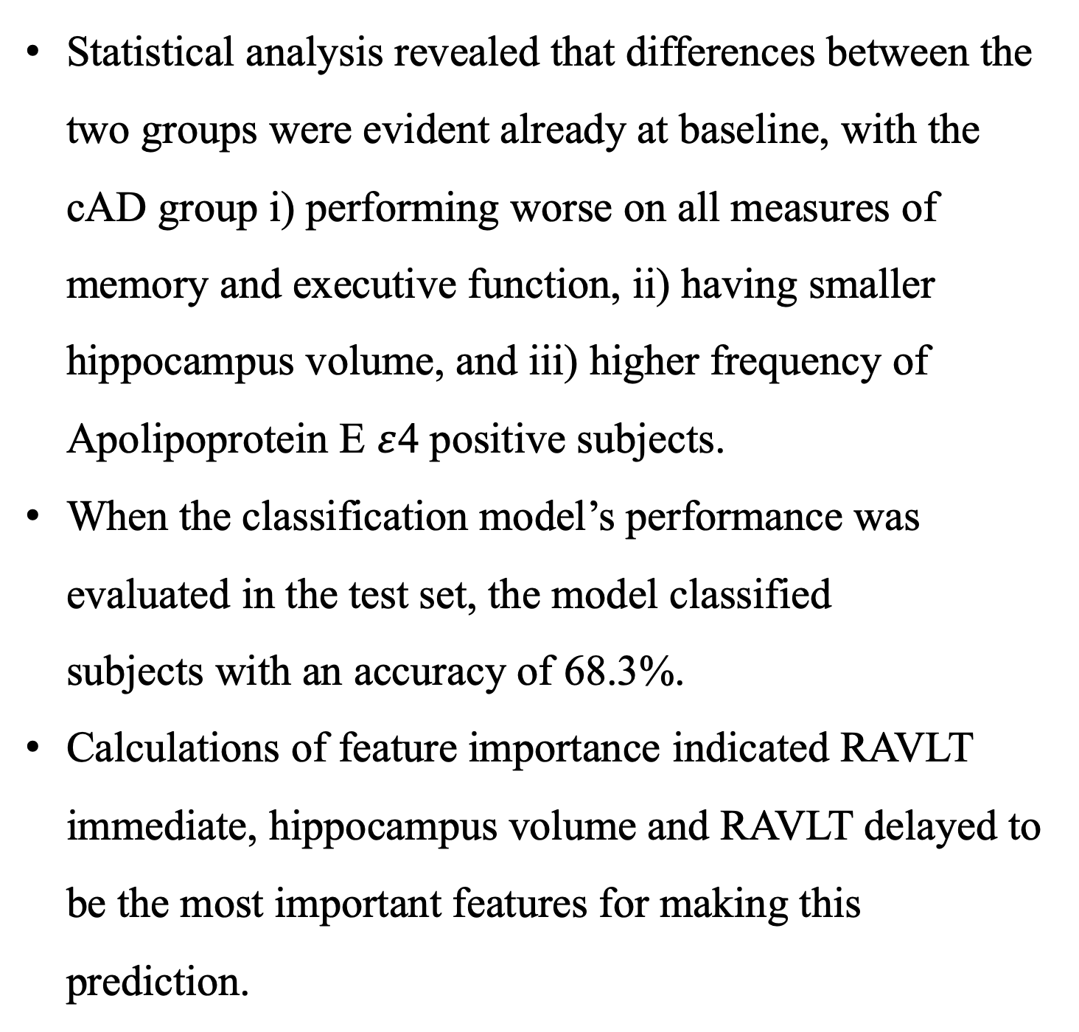
Trajectories from Mild Cognitive Impairment to Alzheimer’s Disease:
A machine learning approach in the context of precision medicine
PT-20
Ingrid Rye ^{a,b}, Marek Kocinski^{a,c}, Alexandra Vikª, Alexander S. Lundervold^{a,d}, Astri J. Lundervold^{b}
ªMohn Medical Imaging and Visualization Centre (MMIV), Department of Radiology, Haukeland University Hospital
^{b}Department of Biological and Medical Psychology, University of Bergen & K. G. Jebsen Centre for Research on Neuropsychiatric Disorders
^{c}Department of Biomedicine, University of Bergen & Mohn Medical Imaging and Visualization Centre, Department of Radiology, Haukeland University Hospital
^{d}Department of Computer science, Electrical engineering and Mathematical sciences, Western Norway University of Applied Science
Introduction
Results
Table 1.
Descriptive and Comparative Statistics for demographic and clinical data. Analysis conducted with Student’s t test for independent samples for (χ² test for the categorical variables Gender and Apoe 4).
Mild Cognitive Impairment (MCI) is a diagnostic construct encompassing patients who experience an objective cognitive decline in one or multiple cognitive domains, but where the impairment is not severe enough to interfere with daily function (i.e., patient is not demented).
If the phenotypic profile of an MCI patient is defined by a primary memory impairment, it is referred to as amnestic MCI (aMCI), and this state is associated with a ten-fold increased risk for developing AD [2]. aMCI is, however, characterized by great heterogeneity and a substantial proportion will stabilize at MCI and some may even revert back to normal cognitive function [3]. Being able to early and reliably identify which aMCI patients are on a trajectory towards AD is therefore of great importance.
Statistical analysis revealed that differences between the two groups were evident already at baseline, with the cAD group i) performing worse on all measures of memory and executive function, ii) having smaller hippocampus volume, and iii) higher frequency of Apolipoprotein E $ε$4 positive subjects.
When the classification model’s performance was evaluated in the test set, the model classified subjects with an accuracy of 68.3%.​
Calculations of feature importance indicated RAVLT immediate, hippocampus volume and RAVLT delayed to be the most important features for making this prediction.
Figure 1. Adapted from Sperling et al. [1]
Note. Effect sizes are reported as Cohen’s d for continuous variables and Cramer’s φ for categorical variables. Abbrevations: sMCI = stable Mild Cognitive Impariment; cAD = converted to Alzheimer’s disease; RAVLT = Rey Auditory Verbal Learning Test; CGS = Geriatric Depression Scale; ANART = American National Adult Reading Test.
Figure 4.
The 2x2 confusion matrix is computed for the sMCI and cAD labels returned from the model (horizontal axis) on the test set compared with the cooccurrences of the observed outcome (vertical axis). The dark cells represent correctly classified subjects, while the light and orange cells represent misclassifications. The numbers listed in each cell are the of subjects
and percentage of the total test set.
Figure 3.
Feature importance calculated by decrease in impurity from evaluation on cross validation procedure (top) and test set (bottom). The 12 features included are displayed on the y-axis while the x-axis shows their relative importance. The black error bars indicate a 95% confidence interval.
Methods
Conclusion and future directions
Subjects: Participants defined as aMCI by ADNI’s criteria at their initial study visit were divided into two groups based on longitudinal diagnostic labels: subjects remaining stable with MCI (sMCI, n = 381, age range 55-91) and subjects converting to AD (cAD, n = 327, age range, 55-88).
Data: Variables included were chosen to represent a proxy of a clinical examination at a memory clinic. This resulted in 12 variables including baseline measures of memory and executive function, depressive symptoms, intellectual function, total volume of hippocampus, and Apolipoprotein E genotype.
Analytic approach: A supervised machine learning classifier, Random Forest, was used to predict subject’s class (sMCI vs. cAD) from the selected variables. In model construction, the full data set was stratified into a training set (80%) on which the model was trained, and a test set (20%) held aside for a final validation of model performance. To avoid overfitting the model to training data, a 10-fold cross validation procedure was implemented. Lastly, extensive grid searches were conducted to optimize the models hyperparameters.
The present algorithm’s accuracy of 0.68, although much better than chance, is far from perfect. Nevertheless, this study takes a step towards a precision psychology/medicine approach to AD research by including high dimensional data from several modalities within a supervised machine learning analytic framework. With increased knowledge about core factors associated with AD, the future holds great promise for developing algorithms that can lend support to clinicians in their diagnostic and prognostic decision making.
“Precision psychology” and machine learning
Alzheimer’s Disease Neuroimaging Initiative
Precision psychology can be defined like precision medicine as an “emerging approach for disease treatment and prevention that takes into account individual variability in genes, environment, and lifestyle for each person” [4]. This holds great promise for improving healthcare across several domains. Over the past decades, the research field of AD has moved away from aiming to explain the disease due to a single causal mechanism, such as the “amyloid cascade hypothesis” [5]. Focus has to a larger degree been directed towards how AD develops as a result of the accumulative effect of several risk factors combined. Different pathological mechanisms can lead to the same clinical presentation, also referred to as equifinality [6]. For instance, many people present with high loads of plaques of amyloid beta and tau tangles, the two hallmarks of AD, without having cognitive impairments. This shows that AD is a high dimensional disease, where several risk and resilience factors (also existing on a continuum) must be considered. Machine learning methods that are inherently capable of finding novel patterns in complex data can be well-suited to explain which risk and resilience factors interact in individual instances of the disease.
ADNI is one of the the world’s leading research projects on AD, with a main aim to develop biological markers for early detection of AD pathology. It is a natural history study initiated in 2003 and still ongoing in its fourth study phase which is scheduled to end September this year. Through the ADNI project, both clinical, genetic, brain imaging, and biological data have been collected longitudinally from participants at 59 different research centres in the United States and Canada. Participants in the ADNI study include elderly individuals with i) early Alzheimer’s disease, ii) early Mild Cognitive Impairment, iii) late Mild Cognitive Impairment, iv) Subjective Memory Concern, and v) normal cognition.
References
[3] Koepsell, T. D., & Monsell, S. E. (2012). Reversion from mild cognitive impairment to normal or near-normal cognition: risk factors and prognosis. Neurology, 79(15), 1591–1598.
[4] U.S. National Library of Medicine. What is the Precision Medicine Initiative? 2018. Available online: https://ghr.nlm.nih.gov/primer/precisionmedicine/initiative (accessed on 14 August 2021).
[5] Ricciarelli, R., & Fedele, E. (2017). The Amyloid Cascade Hypothesis in Alzheimer's Disease: It's Time to Change Our Mind. Current neuropharmacology, 15(6), 926–935.
[6] Cicchetti, D. & Rogosch, F.A. (1996) Equifinality and multifinality in developmental psychopathology. Dev. Psychopathology, 8, 597–600.
Figure 2.
Illustration of Random Forest
[1] Sperling, R. A., Aisen, P. S., Beckett, L. A., Bennett, D. A., Craft, S., Fagan, A. M., Iwatsubo, T., Jack, C. R., Kaye, J., Montine, T. J., Park, D. C., Reiman, E. M., Rowe, C. C., Siemers, E., Stern, Y., Yaffe, K., Carrillo, M. C., Thies, B., Morrison-Bogorad, M., . . . Phelps, C. H. (2011). Toward defining the preclinical stages of Alzheimer’s disease: Recommendations from the National Institute on Aging - Alzheimer’s Association workgroups on diagnostic guidelines for Alzheimer’s disease. Alzheimer’s & Dementia, 7(3), 280–292.
[2] Boyle, P. A., Wilson, R. S., Aggarwal, N. T., Tang, Y. & Bennett, D. A. (2006). Mild cognitive impairment: Risk of Alzheimer disease and rate of cognitive decline. Neurology, 67, 441–445.

